Slide 1
A Research Paper
Rohit Seth, Ph.D.

Slide 2
What is a Research
Paper?
Document of scientific findings.
Scientific papers are the heart of the scientific community.

Slide 3
A research paper is an expanded essay that presents ones interpretation or evaluation or an argument.
When anyone write’s a research paper they build upon what they know about the subject and what other experts know.
A research paper involves surveying a field of knowledge in order to find the best possible information in that field.

Slide 4
What are the areas in which one can publish a research papers?
Science
Arts
Humanities
Religion
Management
Language etc.

Slide 5
What is the essence of a science publication?
Science is
Public
Objective
Predictive
Reproducible
Systematic
Cumulative
Publication makes this possible
Final step in discovery

Slide 6
EXAMPLE
BIOMEDICAL RESEARCH

Slide 7
Why should I read?
To find out whether to use a (new) diagnostic test or treatment
To learn clinical course and prognosis of a disease or treatment
To determine etiology & causation
To distinguish useful from useless (or harmful) therapy

Slide 8
Interpretation
Body of a research paper
Introduction What question was studied?
Methods How was the question studied?
Results What was found?
Discussion What do the results mean?

Slide 9
Other parts of a paper
Additions
Title, authors, affiliations
Abstract
Subsections
Tables & figures
References
Acknowledgements & disclosures
Appendices
Electronic supplements

Slide 10

How do I read a research paper?

Slide 11
Read a scientific paper as a critic
Understand the problem
Understand the proposed solution
Understand competing approaches / designs
Evaluate the paper
Peer review is the cornerstone of the scientific publishing process

Slide 12
Evaluating a Paper
What is the problem being solved?
Is it important? Relevant? Why?
What is the prior work in this area?
Is the proposed solution clever?
Cleverness is orthogonal to importance!
Are the assumptions and model reasonable?
Impact
Easier to evaluate for older papers
Does other work build on it? Do other papers uses techniques and solutions proposed in this paper?

Slide 13
Evaluation Process
Read slowly, take notes as you read
Question assumptions, importance of the problem
Write questions to track what you don’t understand
Sometimes what is not in the paper is more important than what is in it
Is there something the authors have overlooked?
Don’t let ideas or design details pass until you understand them!
Do not assume the paper is correct, even if published in a prestigious peer-reviewed venue

Slide 14
Ground Rules
Try to understand
Don’t be afraid to ask
Be constructive
Be polite
Don’t be afraid to criticize (constructively!)

Slide 15
Two Types of Scientific Papers Containing Two Types of Information
Review articles: give an overview of the scientific field or topic by summarizing the data and conclusions from many studies.
Primary research articles: contain the original data and conclusions of the researchers who were involved in the experiments and how the experiments were done.

Slide 16
First read the abstract in order to understand the major points of the work.
It clarifies whether you in fact know enough background to appreciate the paper.
It refreshes your memory about the topic.
It helps you as the reader to integrate the new information.

Slide 17

Continue…
Introduction can be skimmed.
The logical flow of papers goes straight from the Introduction to Results.
Then to Discussion for interpretation of the findings.
This is only easy to do if the paper is organized properly.

Slide 18
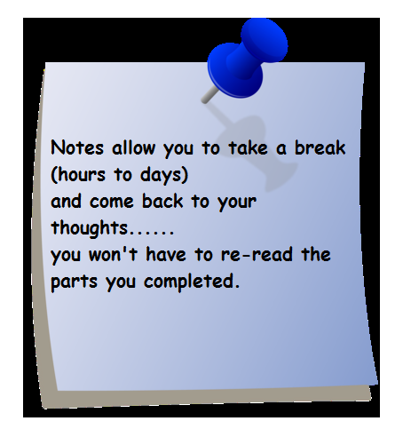
How to read the results…
Examine the figure
take notes
with each experiment/ figure you should be able to explain:
The basic procedure
the question it sought to answer
The results
the conclusion &
Criticism

Slide 19

How to read a discussion
Take notes and answer these questions:
What conclusions did the authors draw?
Opinion/ interpretation?
Ask yourself why is this data significant?
Does it contribute to knowledge or correct errors?

Slide 20

By now, you may be tired of this paper…
But don’t relax yet…
save energy for the overall reflection and criticism.

Slide 21
Reflection and Criticisms
Do you agree with the authors’ rationale for setting up the experiments as they did?
Did they perform the experiments appropriately?
Were there enough experiments to support the major finding?
Do you see trends/patterns in their data?
Do you agree with the author’s conclusions?
What further questions do you have?
What might you suggest they do next?

Slide 22
Reading a scientific paper
Struggle with the paper
Active not passive reading.
Use highlighter, underline text, scribble comments or questions on it, make notes.
If at first you don’t understand, read and re-read, spiraling in on central points.
DO NOT highlight whole sentences or paragraphs

Slide 23
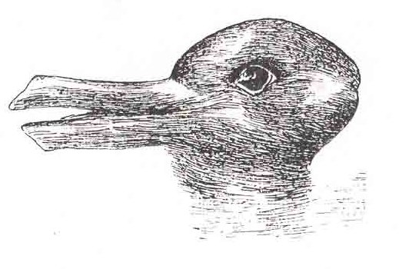
The famous duck-rabbit ambiguous image.
When one looks at the duck-rabbit and sees a rabbit, one is not interpreting the picture as a rabbit, but rather reporting what one sees.

Slide 24


Slide 25
MEDICAL WRITING

Slide 26
The Medical Writer
The best preparation for writing scientific papers is to
Write papers as a time and lifetime priority
Respond responsibly to referees’ reviews of your paper
Referee papers—become a reviewer, editorial board member, maybe even an editor!

Slide 27
Doctors as Writers
Write a scientific paper like you would take care of a patient having a procedure
Preprocedure preparation
Goals (patient care plan)
Sequence of procedure
Postprocedure care

Slide 28
Best Preparation for Writing
A good protocol for study in the first place!
Important question / hypothesis
Clear set of objectives to answer question
Analyses organized by these objectives
See reporting template…

Slide 29
Writing Order
Preparation
Review materials, methods, results
Goals
Establish paper’s message & audience
Select purposes tied to message
Sequence
Finish methods & results
Discussion, introduction, references
Definitive title & authors
Post-writing
Out to co-authors & revise
Revise (seriously) after journal review

Slide 30
Get Down to Business!
Section-by-Section
Overview
What to Look For

Slide 31
Title
What is paper about?

Slide 32
Title
Introduces the work
First thing read
Usually it is ONLY thing read
Serves to entice intended readers

Slide 33
Title
How do you evaluate a title?
Characterize a good title

Slide 34
Title
Characteristics of good titles
Short, but specific (not an abstract!)
Truly represents content
Might…
Be provocative or controversial
Ask a question
Make statement of conclusion
Indexable
Avoid
Qualifiers, jargon, abbreviations, filler

Slide 35
Title
Evaluation
Does title tell you what paper is about?
Does it overstate contents?
Is it too bland to entice readers?
Is it “too cute”?
Does it mislead?

Slide 36
Authors
Who wrote this?

Slide 37
Authors
Why are authors important?
Who should write the paper?
Who should be on author list (if any)?
How many?
What order?
What roles?

Slide 38
Authors
Why important?
Like it or not, it is an issue of authority or expertise or experience (sociology)
Where was work done?
Credibility
Generalizability
Assists evaluating apparent negative results

Slide 39
Authors
Controversies
Who should be an author?
Number of authors
Author order
Conflicts of interest / disclosures
Subject all its own…

Slide 40
Authors
Evaluation
“This paper suffers from lack of input, guidance, and expertise from the senior authors”

Slide 41
Ultra-Mini Abstract
What is the essence of this study—the “take home” message?

Slide 42
If reader is interested…
Robert Day
Clearly stated problem
Clearly stated conclusion
Steven Laureys
Develop a central message and write everything else to support it
JWK / EHB
Ultramini Abstract: essence of findings for writer and reader

Slide 43
Ultramini Abstract
For readers
Scanning tool
For authors (~3 hour’s effort)
Best preparation for writing paper—the roadmap!
Content
Truest 1-3 sentences (~50 words) about the essence of the study—its message—its inferences

Slide 44
Ultramini Abstract
Evaluation
Analogous to the “elevator pitch” for a business
It is not a summary of study purpose or results
It is congruent with conclusions of abstract and paper
It is hard work
It is often done poorly

Slide 45
Abstract
Should I read the article?

Slide 46
Abstract
Meeting abstract
Purpose: to get on program
Paper abstract
Summarizes information and data contained in more complete form in IMRD aspects of manuscript
States conclusions (“bottom line”)
Self contained
#2 item read (after title)

Slide 47
In fact…
For most readers reading selectively and strategically
Skim first line to understand problem addressed
Skim last line for conclusions
No sense
Concluding by merely again summarizing results that have already been summarized!

Slide 48
Abstract
Evaluation
If not structured, read it in structured fashion
Are purposes clearly stated?
Do conclusions match 1:1 the purposes of study
Do methods clearly tell me the study group (e.g. animals, patients)?
Is there supporting data for each stated purpose & conclusion?

Slide 49
Introduction

Slide 50
Introduction
What I like
What I hate
What should it accomplish?

Slide 51
Introduction
What is the Problem?
Why is it Important?
What is the Approach?

Slide 52
Introduction
4 short segments
Problem statement
Does not review field
Why is it important?
What is context?
Purpose of study
Sets complete roadmap for paper
Slavishly followed in order and with same words for rest of paper

Slide 53
Introduction
What reader reads (if at all)
First sentence or two
Last sentence or two

Slide 54
NIH Illustration
7,000 patients will be diagnosed with esophageal cancer this year…
It is a killer…
Its location differs around the globe… Staging system is not data-driven…
Cause is unknown, but environment may play a role. For example…
Barrett esophagus is widely thought to be a precursor… Tums and pizza…
Therefore, we investigated cell signaling related to transformation of squamous epithelium to columnar configuration in nude knockout mice.

Slide 55
Alternative First Sentences
Discovering the cell signaling by which esophageal epithelial cells transform into columnar configuration by gastric acid reflux may lead to better understanding of the pathogenesis and possible prevention of esophageal cancer…

Slide 56
Introduction
Evaluation
Does it rapidly tell me where this paper is headed?
Can it be better focused (“boiled and distilled”)?
Does it make a case for itself?
Are we talking people or animals?
Are purposes clearly laid out AND does the author follow the map?

Slide 57
Materials and Methods
How was the study done?
Should I believe this study?

Slide 58
Materials & Methods
For selective, strategic readers
Rarely read in entirety if at all
Assumes this section has been vetted by peer review process
For reviewers
Inadequacies often identified
For science
Is study valid?
Is it replicable?

Slide 59
Materials and Methods
If patients (for example)
What was done?
Where?
Time frame?
Context?
Inclusion/exclusion criteria?
How many (CONSORT diagram)?
Characteristics of patients?

Slide 60
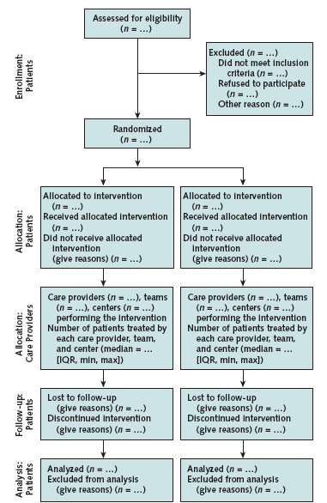
CONSORT Flow Diagram
How was study group assembled?
Base group included
Specific exclusions
Analysis group

Slide 61
Materials and Methods
Intervention
Details
Study protocol

Slide 62
Materials and Methods
End points
Define (eg, all-cause mortality)
If patient follow-up
Passive vs. active
Systematic (vs. opportunistic)
Anniversary
Cross-sectional
Completeness

Slide 63
Materials and Methods
Data analysis
Organize according to purposes of study
Provide detail or references to technical methodology
BUT don’t leave loopholes!
Most common error is not listing variables considered in analyses

Slide 64
Materials and Methods
Presentation
Format of summary statistics
Confidence limits & level
Other special features of presentation

Slide 65
Materials and Methods
Evaluation
A checklist is valuable for authors, evaluators, and readers
CONSORT is one, but journals may have their own
Often contentious
Old methods
Unfamiliar methods
Complex methods

Slide 66
Results
What was found?

Slide 67
Results
What do you look for?
What should be there?
What shouldn’t be there?

Slide 68
Results
Often read selectively and strategically
Figures looked at the most—even though they are the first thing reviewers suggest eliminating
This is core of paper

Slide 69
Results
What results should be shown?
Selected, well-digested data & findings
Relate directly to purposes of paper, organized according to purposes, using identical words
No interpretation
No repetition of text, tables, figures

Slide 70
Results
Part of the truth
Not the whole truth
Themes
Accuracy
Brevity
Clarity
Future
Repository of raw data for reanalysis

Slide 71
Results
Evaluation
Are data presented that convincingly support conclusions?
Logical pieces all there
Results stated accurately
Are there appropriate expressions of uncertainty?
Do negatives reflect underpowered study?
Are methods mixed with results?

Slide 72
Results
Evaluation
Tables
Appropriate
Complete for their purpose
Statistically sound
Figures
Appropriate information content
Complete legend
Readable

Slide 73
Discussion

Slide 74
Discussion
What I like
What I hate
What is purpose?
What order?

Slide 75
Discussion
So what?
Who cares?

Slide 76
Discussion
Failure
If the reader finishes discussion and wonders “So what?”

Slide 77
Discussion
What do results mean?
Interpretation
Relationships among results
Generalizations
Theoretical implications

Slide 78
Discussion
What do results mean?
How do they relate to cumulative knowledge?
Support
Contradict
Completely new
How should I use them?
Practical application

Slide 79
Discussion
Suggested outline
Summarize findings (controversial)
Principal findings
Organized by purpose-driven roadmap
Put results in context of others
Limitations
Conclusions
inferences
Recommendations

Slide 80
Discussion
Evaluation
Is it concise and focused strictly on purposes of study?
Is interpretation of study reasonable?
Have others been quoted and represented accurately?
Are inferences supported by results?
Is speculation identified?
Are there promissory notes?
Are new results presented?

Slide 81
References
Can I verify claims and arguments?

Slide 82
References
Not exhaustive
30 or less is sufficient
Not just recent literature
Contextual
Place subject in context
Represents all sides of controversy
Truly relevant
Cited accurately
NLM has a problem!

Slide 83
Summary
Science = publication
Format stereotyped (signposts)
Readers selective and strategic
They rely on reviewers to vet scientific validity
Conclusions (message) key
May have life-and-death implications—and more
Impact of use unstudied!

